Slide 1
Agile for Model-Based Standards Development
Brandon Sapp
Melissa Harvey
Sylvere Krima
Marion Toussaint

Slide 2
Presentation Overview
Agile:
Program Increment/Iteration
Agile Release Train/Agile Team and Velocity/Estimation
Requirements Management
Continuous Integration
Living Lab:
Bugzilla to JIRA
STEPMOD to STEPDEV [CVS to GIT] Proof of Concept

Slide 3
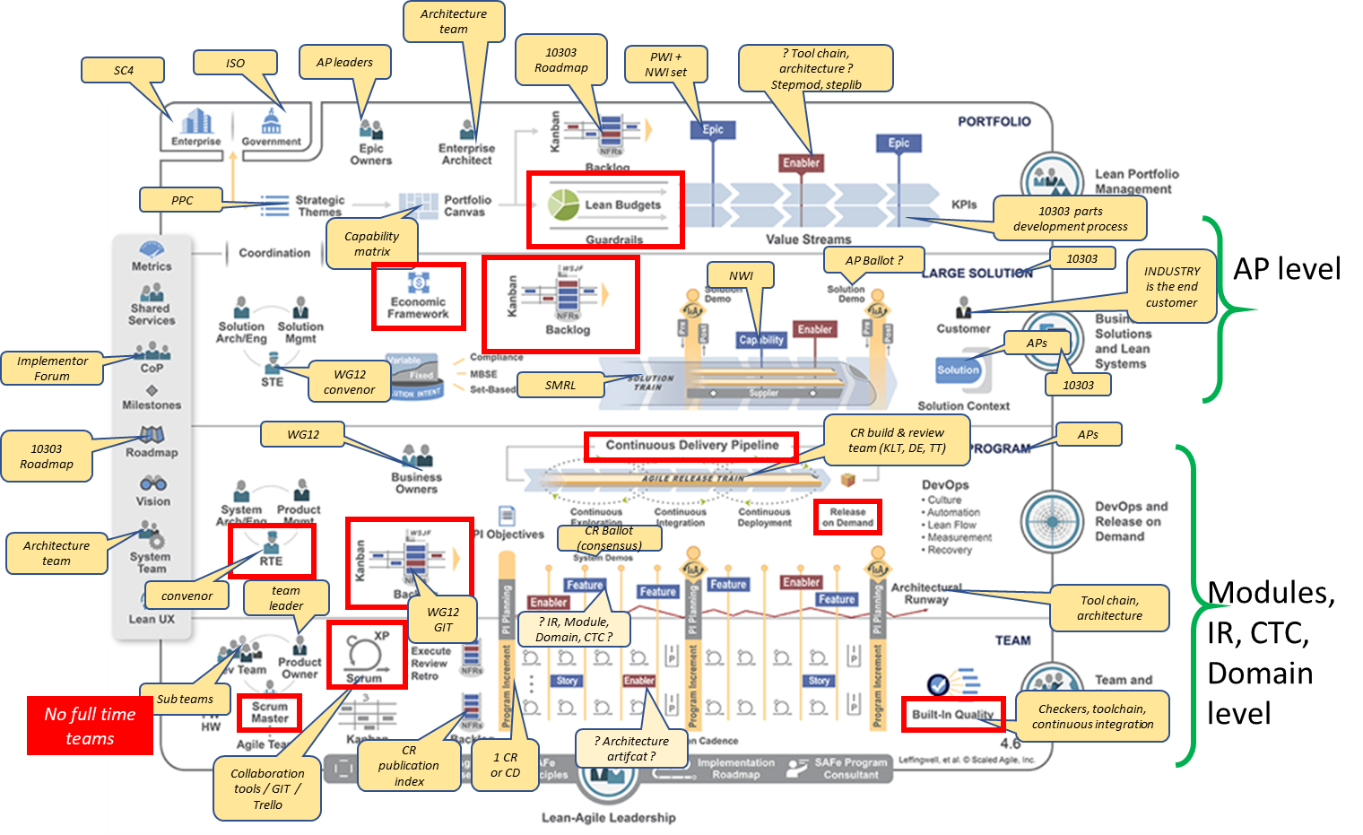
SAFe Framework Mapping Proposed by Jean Brange

Slide 4
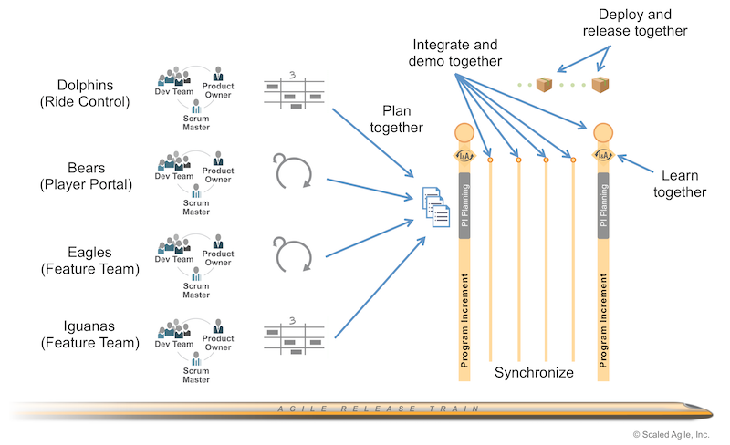
Agile Release Train
https://www.scaledagileframework.com/agile-release-train/

Slide 5
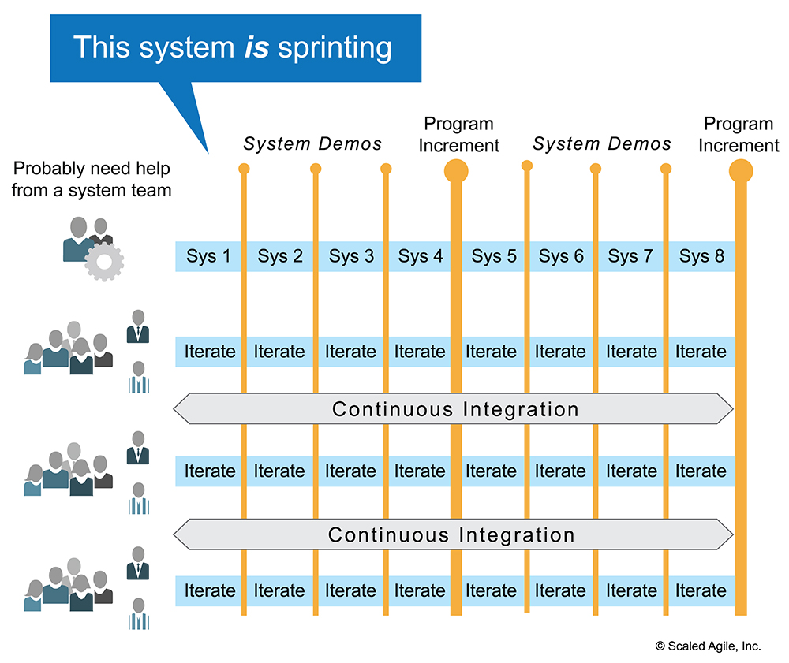
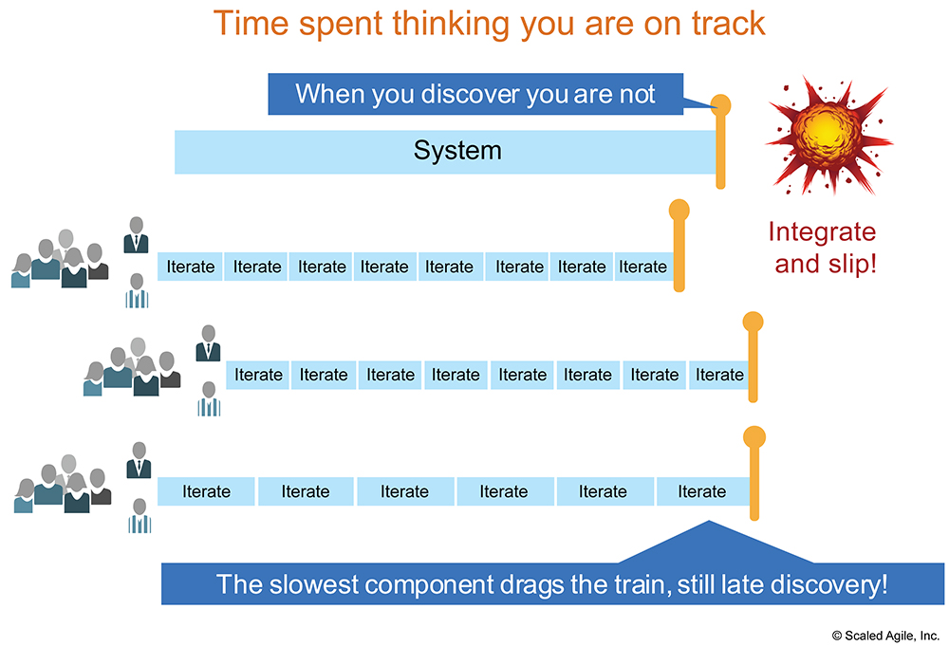
Agile Release Train Works Together
https://www.scaledagileframework.com/agile-release-train/

Slide 6
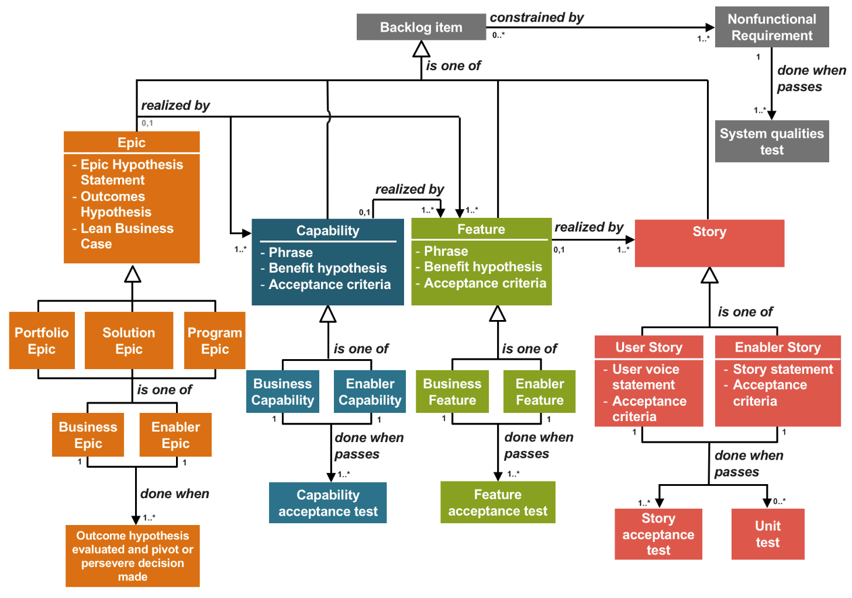
Requirements Management
SAFe Requirement Model
EPIC [New Work Item] : AP242e3
Capability: Installation PMI
Feature: Installation Holes
Story: Implicit/Simplified Counterdrill Hole
Story: Implicit/Simplified Countersunk Hole
Feature: Installation Fastening Hardware
Story: Implicit/Simplified Rivets
Story: Implicit/Simplified Bolts/Nuts
EPIC [New Work Item] : Isogeometric Analysis
EPIC [New Work Item] : xxx
https://www.scaledagileframework.com/safe-requirements-model/

Slide 7
TERM Definitions
Program Increment: A Program Increment [PI]] is a time box which an Agile Release Train [ART] delivers incremental value tin the form of a working, tested software and systems. The most common pattern for a PI is four development iterations, followed by one Innovation and Planning Iteration.
Iterations: Iterations are the basic building block of Agile development. Each iteration is a standard, fixed-length time box, where Agile Teams deliver incremental value in the form of working, tested software and system. The recommended time box is two weeks. However, one to four weeks is acceptable, depending on the business context.
Agile Release Train: The Agile Release Train [ART] is a long-lived team of Agile Teams, which, along with stakeholders, incrementally develops, delivers, and where applicable operates, one or more solutions in a value stream.
Agile Team: An Agile Team is a cross-functional group of 5 to 11 people who have the responsibility to define, build, test, and where applicable deploy, some element of the Solution all in a short iteration time box. Includes Developers, Scrum Master and Product Owner roles.

Slide 8
TERM Definitions
EPIC: An EPIC is a container for a Solution [Product, Service or System delivered to the customer] development initiative large enough to requirement analysis and financial approval.
Capability: A Capability is a higher-level solution behavior that typically spans multiple ARTs. Capabilities are sized into multiple features to facilitate their implementation in a single Program Increment [PI]
Feature: A Feature is a service that fulfills a stakeholder need. Each feature includes a benefit hypothesis and acceptance criteria, and is sized or split as necessary to be delivered by a single Agile Release Train in a Program Increment [PI]
Story: Stories are short descriptions of a small piece of desired functionality, written in the user’s language. Agile Teams implement small, vertical slices of a system functionality and are sized so they can be completed in a single iteration.

Slide 9




Proposed Solution 2: Agile Release Train
Agile for Model-Based-Standards Development
AP239e4 (ART/EPIC)
AP243e1 (ART/EPIC)
AP242e3
(ART/EPIC)
PMI Team
Define
Build
Test
Deploy
Agile Teams
EWH
Team
Define
Build
Test
Deploy
AM Team
Scrum Master Product Owner Development Team
Notes:
Problem with traditional development methods leads to long project phases for:
requirements documentation
product development
integration
Review
Publication
Agile represents an opportunity to
shorten the development
Provide usable products to the user faster
Applicable Manifesto:
“Deliver working software frequently.”
“Working software is the primary measure of progress.“
“At regular intervals, the team reflects on how to become more effective, then tunes and adjust its behavior accordingly.”
Recently integration issues with AP242 e2 teams could have been avoided with synchronized and integrated development iterations
employing systems thinking and applying an operating cadence and synchronization that enables all the teams to sprint together while integrating

Slide 10
Proposed Solution 3: Program Increment Planning
Agile for Model-Based-Standards Development
AP242e3
(ART/EPIC)
Hole & Fastener Extension
(Features, Improvements, Tasks)
program increment
(1-4 wks work)
program increment
(1-4 wks work)
PMI Team
Implicit Holes
Implicit Fasteners
Explicit Holes
Explicit Fasteners
Define
Build
Test
Deploy
EWH
Team
Features, Improvements, Tasks
program increment
program increment
Define
Build
Test
Deploy
User Story
User Story
User Story
User Story
AM Team
Agile Teams
Scrum Master Product Owner Development Team

Slide 11
Continued Research 1: Advanced Communication Tools
Agile for Model-Based-Standards Development
Requirements traceability
Requirements:
come from different sources: users, implementers, domain experts, …
in different forms: email, spreadsheet, word document, meetings, …
change during the development cycle
Requirement to be structured/semantic and computer interpretable for automation optimization (i.e. Req-IF)
Agile offers methods for requirements traceability
These methods need tools to be implemented
Existing tools do not share a common requirement representation and management strategy
Because of that inconsistency, there is limited integration between the tools involved
Develop and implement a requirement model and management strategy
To ensure consistent definition, management and validation of the requirements
ART

Slide 12
Continued Research 2: Advanced Communication Tools
Agile for Model-Based-Standards Development
Consensus management
STEP experts:
Are geographical dispersed
Can’t always attend all the meetings
Cannot always be dedicated
Importance of keeping track of and documenting all the activities and decisions during the different meetings
Decisions can be achievements, new tasks, bugs, bug resolutions, requirements, assignments, …
Meeting minutes are not necessarily very detailed, formalized, and accessible
Who, When, Where, What, Why, How
Develop and implement a formal meeting minutes model and strategy
Easier access to the minutes
Minutes traceability to requirements and tasks
Supports report generation, automation, and single source of truth
ART

Slide 13
Continued Research 3: Continuous Integration
Agile for Model-Based-Standards Development
Continuous integration
STEP development process:
currently involves a set of bespoken tools (validation, documentation, packaging, …)
Will involve new tools after transitioning to Agile
These tools need to be integrated into a global management system to ensure consistency across and integration of their data objects
Tool integration will:
Enable the creation of an automation pipeline
Enable automated testing and validation of models and derived parts (documentation, publication, …)
Improve the quality of the standard by detecting errors earlier in the workflow
Ensure that requirements are properly met
Reduce development and maintenance cost through automation
ART

Slide 14
Benefits & Impacts
Agile for Model-Based-Standards Development
Benefits to MBS Developer
Benefits to Industry/Enterprise
Avoid “integration hell”
Increased standards coverage and quality
Improve quality and testability
Faster delivery
Immediate feedback loop to detect and fix issues early
Reduction in interoperability costs
Increased transparency and visibility across developers and team members

Slide 15
Next Steps
Agile for Model-Based-Standards Development
Implement:
Backlog Management
JIRA or GIT KANBANs
Agile Release Train
JIRA Workflow Management
Program Increment Planning
JIRA Workflow Management
Planning Poker, T-Shirt Sizes, Dot Voting
Continued Research:
Advanced Communication Tools (for consensus management; requirements traceability)
Continuous Integration Tools & Automation (Bitbucket/Bamboo, Jenkins, AWS CodePipeline, and Gitlab)
EXPRESS Engine, JSDAI Compiles, Python scripts or ANT Builds
Draft presentation distributed end of September

